Slide 1
Distributed Network Programming
Prativa Nyaupane

Slide 2
Review
Working with URLs and URL Connection Class
Email Handling using Java Mail API

Slide 3
Outline
TCP
UDP
IP Address
Ports
Socket Programming using TCP and UDP
Working with URLs and URL Connection Class
Email Handling using Java Mail API
Architecture of RMI
Creating and Executing RMI applications
Architecture of CORBA
RMI vs CORBA
IDL and Simple CORBA Program

Slide 4
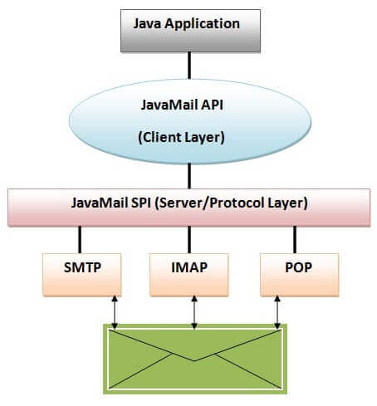
JavaMail Architecture
The java application uses JavaMail API to compose, send and receive emails.
The JavaMail API uses SPI(Service Provider Interface) that provides the intermediatory services to the java application to deal with the different protocols.

Slide 5
Steps of using Java Mail API
Configure the mail server properties such as the host and port.
Establish a mail session with the configured properties
Pass authentication details if required.
Construct an email message using the MimeMessage class.
Set the sender, recipients, subject, and body of the email
Use the Transport class to send the message

Slide 6
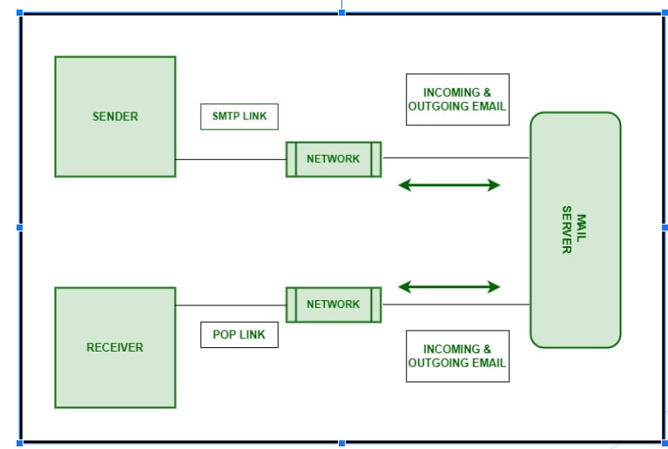

Slide 7
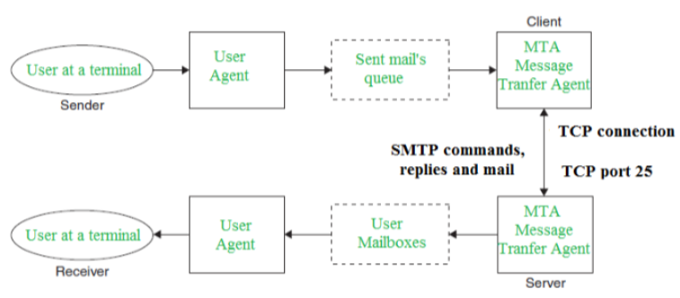
SMTP Model
Mail User Agent (MUA)
Mail Submission Agent (MSA)
Mail Transfer Agent (MTA)
Mail Delivery Agent (MDA)

Slide 8
Working of SMTP
Communication between the sender and the receiver :
The sender’s user agent prepares the message and sends it to the MTA. The MTA’s responsibility is to transfer the mail across the network to the receiver’s MTA.
To send mail, a system must have a client MTA, and to receive mail, a system must have a server MTA.
Sending Emails:
Mail is sent by a series of request and response messages between the client and the server. The message which is sent across consists of a header and a body. A null line is used to terminate the mail header and everything after the null line is considered the body of the message, which is a sequence of ASCII characters.
The message body contains the actual information read by the receipt.
Receiving Emails:
The user agent on the server-side checks the mailboxes at a particular time of intervals. If any information is received, it informs the user about the mail.
When the user tries to read the mail it displays a list of emails with a short description of each mail in the mailbox. By selecting any of the mail users can view its contents on the terminal.

